Slide 1
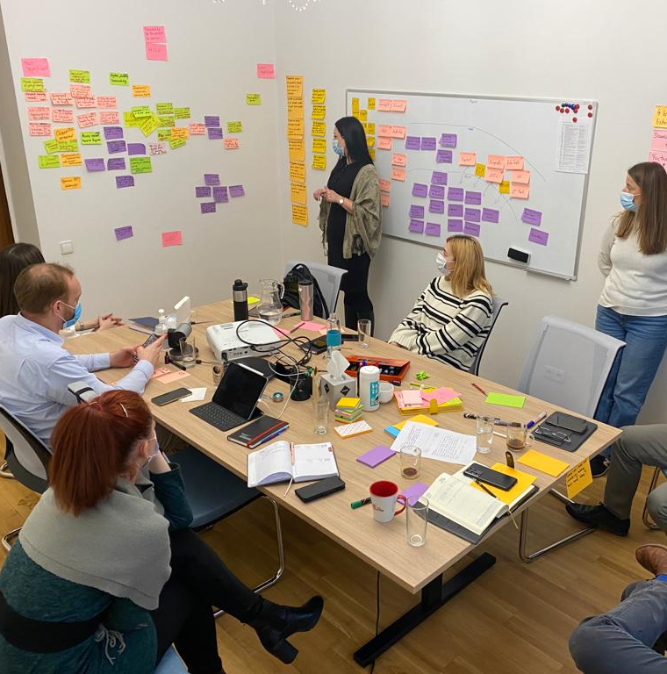
Helvetas‘
outcome harvesting experiences
Kai Schrader
Senior Advisor Evaluation & Learning
Zurich, 01.09.2022
© Simon B. Opladen

Slide 2
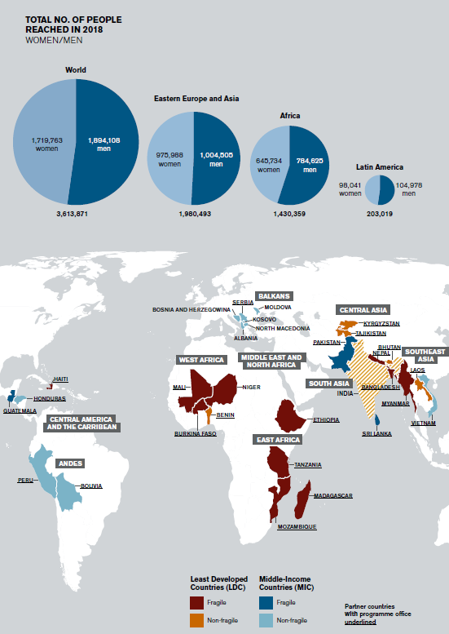
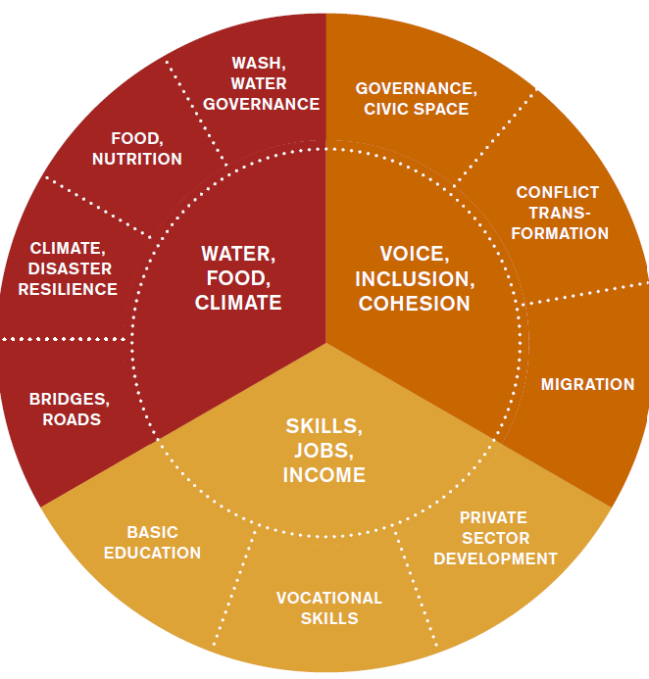
Background
Helvetas claims to be a Learning Organization that prioritize participatory, inclusive and learning-oriented approaches for planning, implementation and evaluation
Helvetas works in over 32 countries with around 250 own and mandated projects a year in a broad thematic variety (clustered in 9 thematic fields)
→ This opens opportunities to apply and learn from many different methodologies to measure and assess outcomes and impact – being Outcome Harvesting one of these

Slide 3
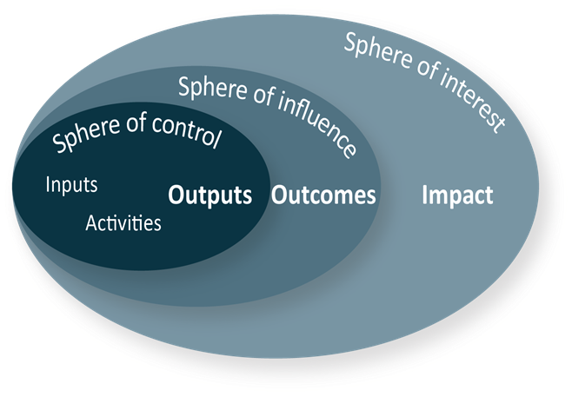
Outcome Mapping and Harvesting at Helvetas
Outcome Mapping (first experience)
MATOY Project with SAHA in Madagascar 2013-16
https://www.saha.mg/cooperation-suisse-programme-matoy/
https://vimeo.com/38146769
Outcome Harvesting for Youth Employment Projects in Eastern Europe
EYE Enhancing Youth Employment Kosovo Phase II, 2017-20
Market Makers Bosnia&Herzegovina Phase II, 2017-21
Risi Albania Phase II, 2017-21
OPTIM Moldovia 2018-22
All four projects are SDC funded, aiming at enhancing employment for young women and men in the countries through:
job creation through private sector development,
job matching and mediation, and
skills development
Focus for the Outcome Harvesting is on the Information and Communications Technology (ICT) sector

Slide 4
Objectives of the Outcome Harvesting
Context
The region faces serious challenges, which undermine the social, economic and political stability.
Overall unemployment rates within Eastern Europe and Western Balkan are high, particularly amongst youth (often above 50%).
Objectives of the Outcome Harvesting
Better understand the effects and effectiveness of Market Systems Development (MSD) projects
Explore a better way to capture rich but hard-to-measure and unanticipated changes in the complex and dynamic contexts
Help the projects teams learn and improve what they do
Document evidence that shows that the projects’ interventions have achieved observable results;
Contribute to learning in the practice of market systems development by disseminating the results and experiences of the study.
Test the efficacy of outcome harvesting in complementing the projects’ internal monitoring and results measurement (MRM) system
Key questions to answer
Have the projects influenced thinking, attitudes, behaviours, ‘mood’, and the way things are assessed, planned and done in the targeted systems?
Have the projects influenced the way people look at gender relations and at people from minority ethnic groups and their participation in the workforce?
How have the projects contributed to these changes?

Slide 5
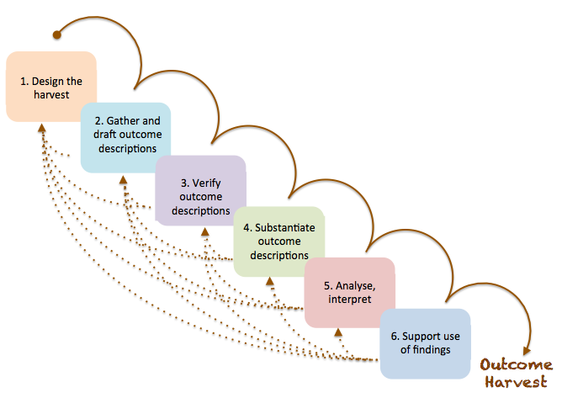
Methodology I
Outcome Harvesting does not measure progress towards outcomes, but rather collects evidence of what has been achieved, and works backward to determine whether and how the project or intervention contributed to the change.
Wilson-Grau, R. (2019). Outcome Harvesting: Principles, Steps, and Evaluation Applications. Charlotte, NC: Information Age Publishing.
This process started with a question by Helvetas: Are we making a difference with our projects in the Western Balkan?
Figure 1 Six steps of the Outcome Harvesting Process (adopted from Wilson-Grau)

Slide 6
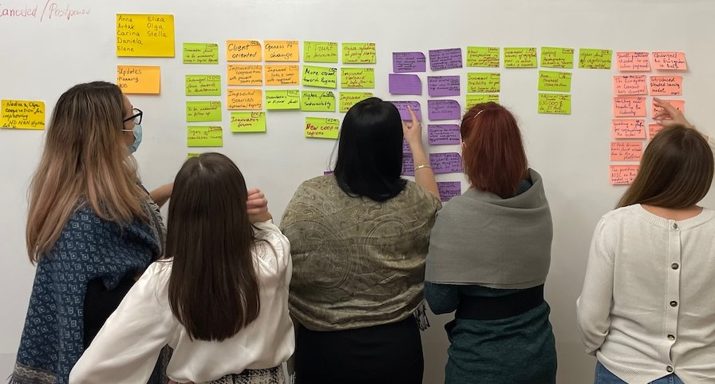


Methodology II
The aim is to collect (harvest) as many Outcomes (i.e. observable and significant changes in the context) as possible and assess the contribution of the project to these Outcomes.
The types of Outcomes and their patterns do not only provide evidence on projects’ effectiveness, but also give insights to learn and adapt projects
In order to substantiate and verify the outcomes, the consultants ran a number of key informant interviews.
Furthermore, a group of external sector experts were invited to give feedback on the credibility of the narratives for each project.
Analysis and interpretation of the outcomes and patterns were predominantly done during a 2.5-day sensemaking workshop
The majority of outcomes were harvested during a two-day workshop with each project team independently
Consultants/facilitators: Marcus Jenal (Mesopartner) and Steff Deprez (Voices that Count)

Slide 7
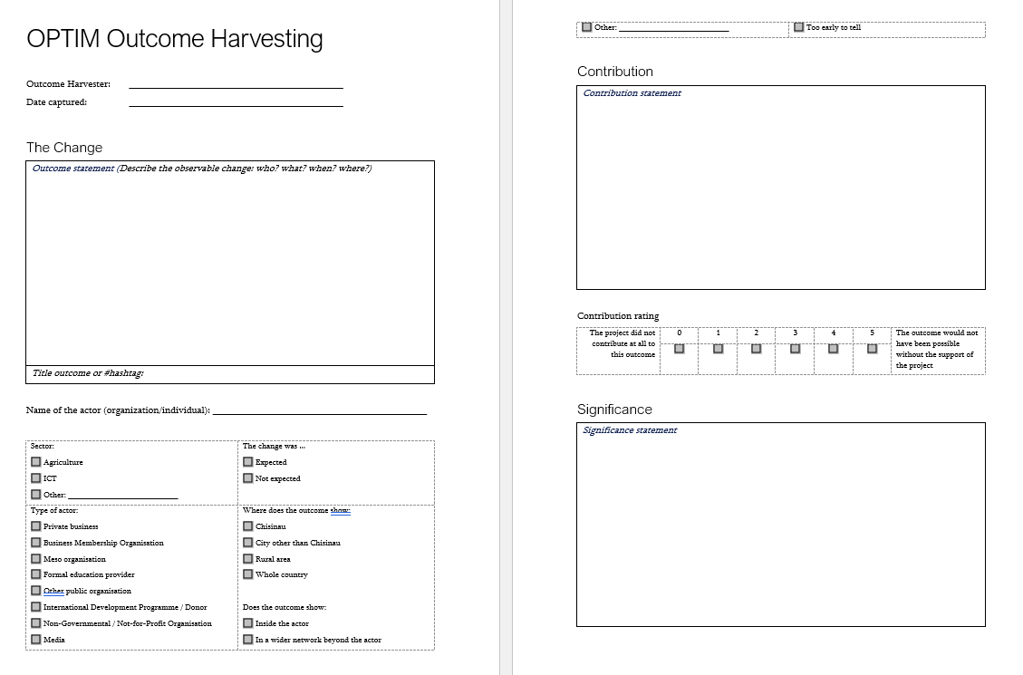
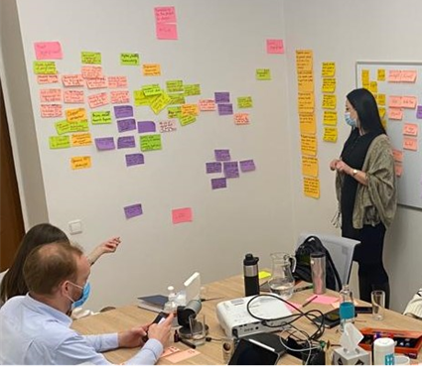
Outcome Harvesting workshop steps
Introduction of the Outcome Harvesting.
Mapping all actors, the project has directly worked with or has influenced
For each actor, listing all outcomes that have been achieved, if any.
Cross checking outcomes and adding any that were not added based on the actor map.
Describing all outcomes, including contribution statements and significance statements.
Adding contribution and significance ratings to each outcome.

Slide 8
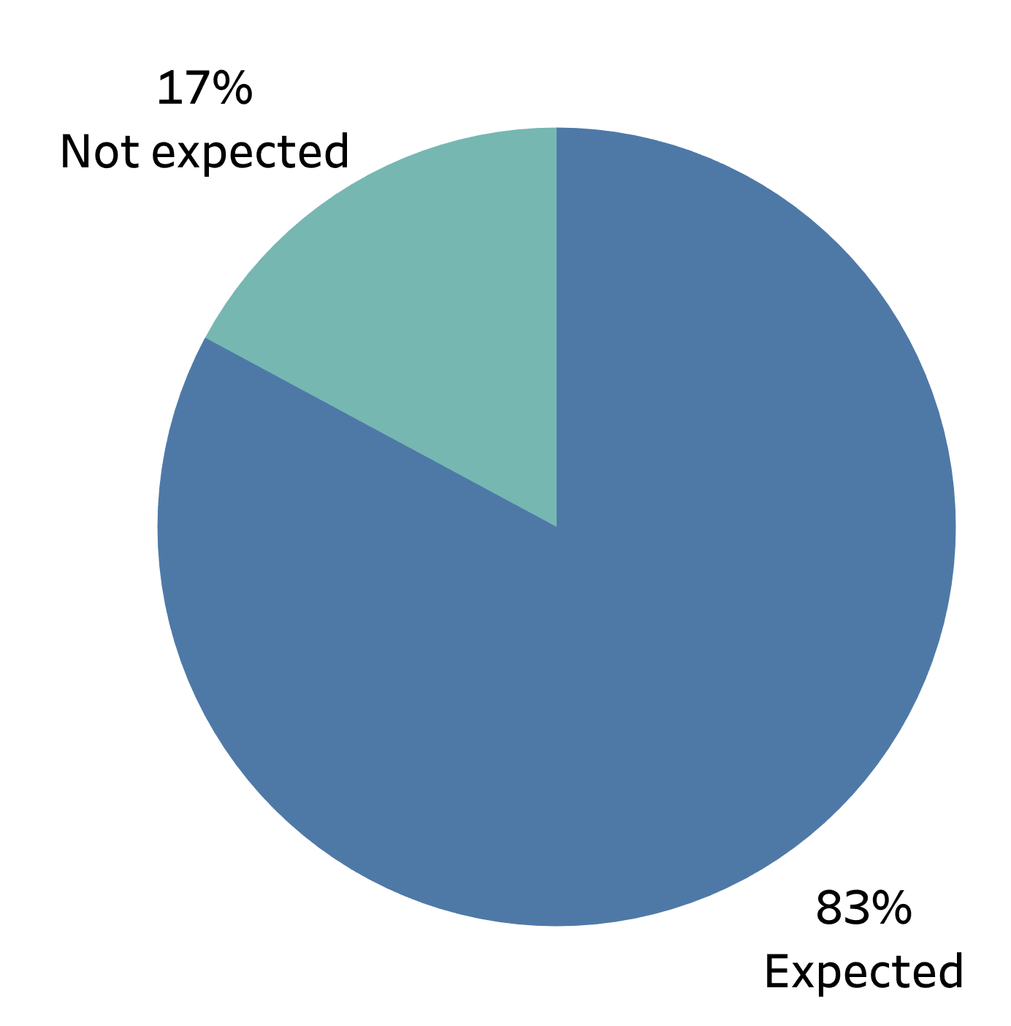
Results I: Outcome Patterns of 3 Balkan projects
Figure 5 Total number of outcomes per outcome dimension
(per country)

Slide 9
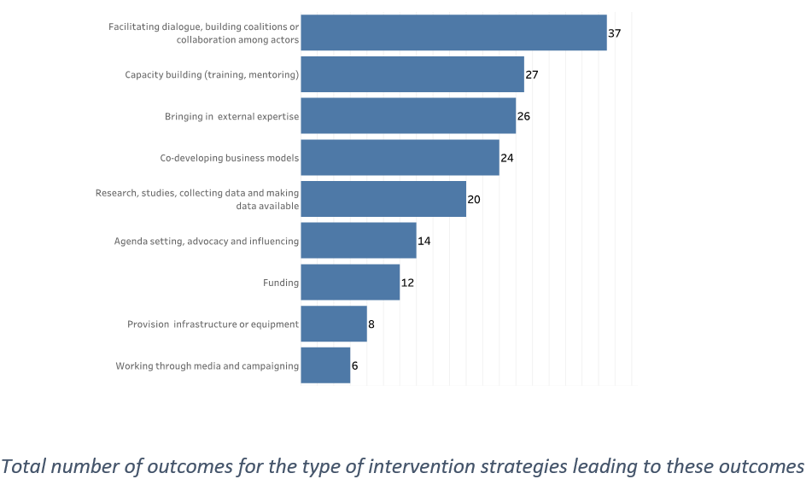
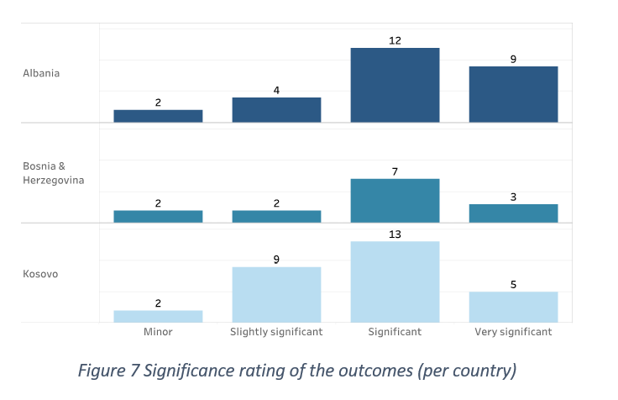
Results II: Outcome Patterns of 3 Balkan projects

Slide 10
Pros and Cons of Outcome Harvesting
Added value of Outcome Harvesting | Main concerns
A good way to document a project’s achievements A way to systematically observe and continuously capture observations Complementing ‘hard’ data in reports with qualitative data Adapting interventions based on regular reviews of the Outcomes Information collection and learning in one process Capturing data that is not yet collected in the MRM system (also makes the MRM job easier) Infuses different/new information into regular strategic reviews Can be adapted and ‘right sized’ for each project Can be used to get the view from partners Adds a new layer about systemic change to ‘standard’, linear MRM Also adds learning about how change happens | Not everybody is a ‘natural harvester’ and can well communicate outcomes Additional resources needed – is the added value big enough to justify the investment? Integrating Outcome Harvesting into regular MRM activities and processes might be challenging How to communicate findings?

Slide 11
Lessons Learned and concluding remarks
The occasional Outcome Harvesting
Helps to look at wider system and see the before-after picture in context setting
Is highly qualitative and subjective, thus requires cross check / verification with partners and external experts
Complements the M&E system
Development practitioners are under increasing pressure to … report achieved results in the form of hard numbers, for example “number of jobs created”, “amount of income generated” or “number of businesses that show growth and competitiveness” – often combined with the need to show value for money, i.e. that the project got the most out of the money they received from the funders.
What gets lost in these numbers is their context: the nuances of how the changes were achieved, what challenges the projects faced and how they managed to get through them. In a complex environment, these nuances matter, details matter. Knowing how a particular change is achieved might be more insightful than how many people it has reached because this is where we can learn about how things work.
An important aspect of the sensemaking workshop was not only to look back at what changes have happened but also to look forward and learn from the patterns that can be seen in the outcomes. This is how Outcome Harvesting can directly feed into decision-making about the way forward and support adaptive management

Slide 12
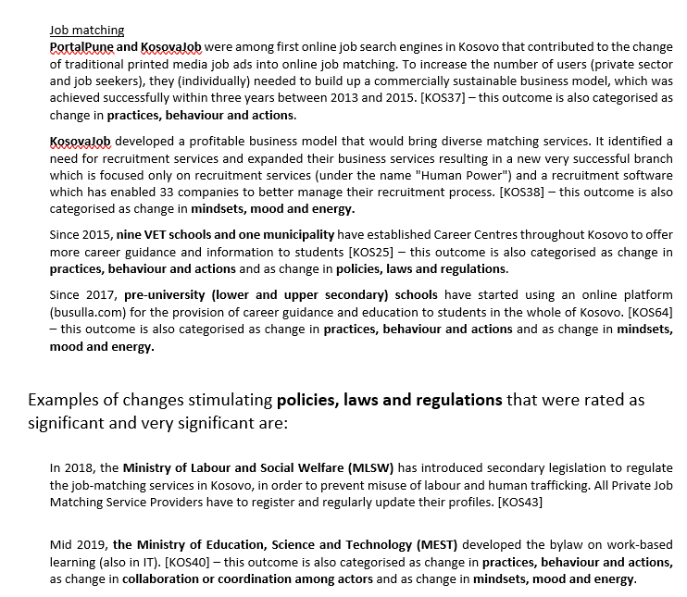
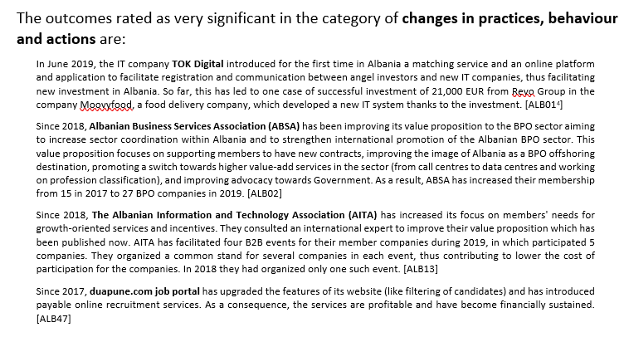
Outcome examples

Slide 13
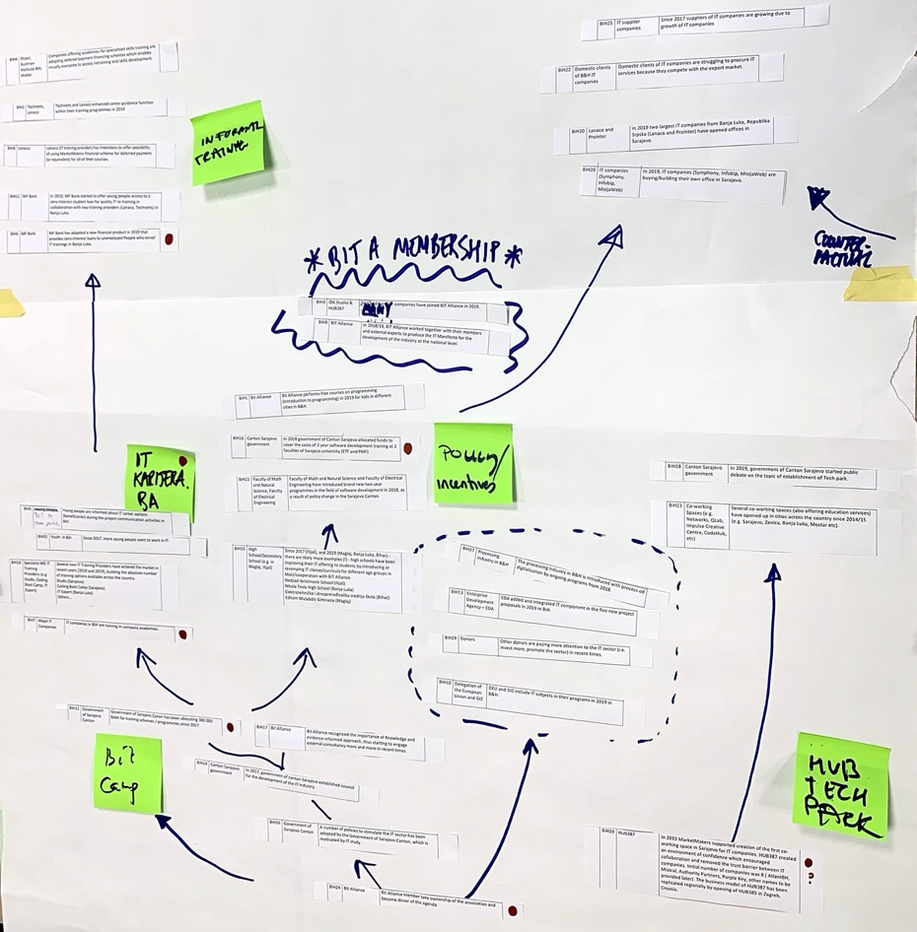
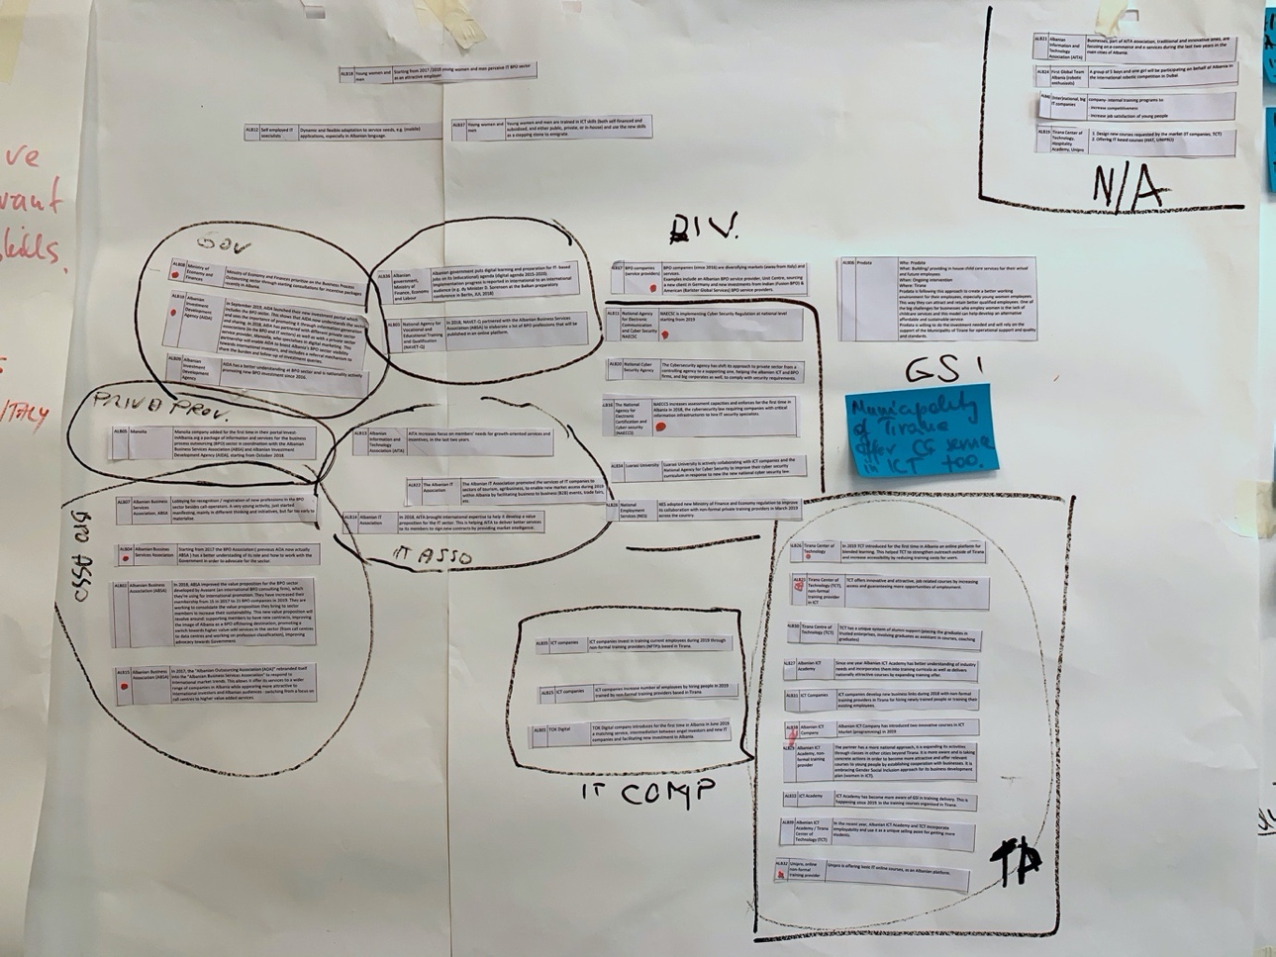
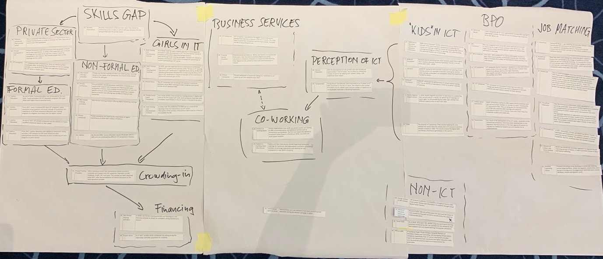
Thank you

